Slide 1
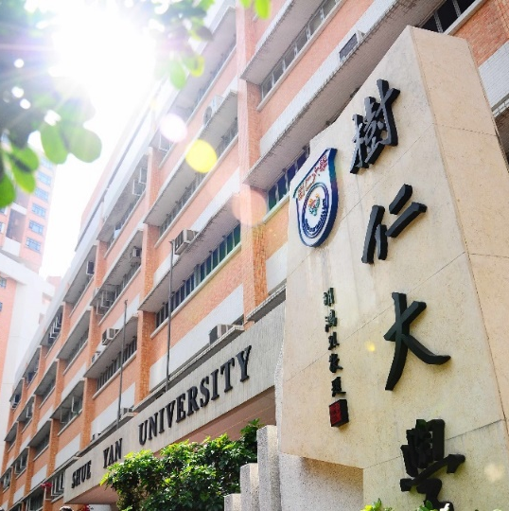
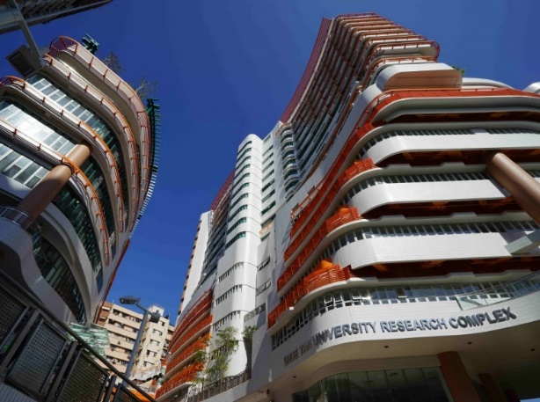
2023-24 年度
三年級同學修科指引
(四年共修125學分畢業)

Slide 2
Third Year |  |  | Credits
Compulsory Courses
Departmental Core Requirements: |  |  | 6
SOC. | 307 | Entrepreneurship and Society
SOC. | 308 | Culture, Heritage and Society
Concentration Departmental Elective Courses (Choose 6 credits according to your chosen concentration) |  |  | 6
Entrepreneurship and Community Concentration
SOC. | 309 | Community Economy
SOC. | 310 | Social Enterprise in Asia
SOC. | 358 | Poverty, Social Policy and Social Innovation
Culture, Heritage and Innovation Concentration
SOC. | 311 | Sustainable and Innovative Cities in the Contemporary World
SOC. | 312 | Popular Culture in Asia
SOC. | 362 | Tourism and Culture
SOC. | 371 | Chinese Culture and Society
Non-concentration Departmental Elective Courses* (Choose 12 credits) |  |  | 12
SOC. | 302 | Environmental Sociology
SOC. | 313 | Sociology of Education
SOC. | 321 | Economic Sociology
SOC. | 333 | Urban Sociology
SOC. | 334 | Sociology of Deviance
SOC. | 336 | Love, Family and Kinship
SOC. | 337 | Criminology
SOC. | 339 | Sociology of Religion
SOC. | 341 | Sociology of Development
SOC. | 356 | Gender Relation
SOC. | 357 | Migration and Mobility
SOC. | 359 | Self, Emotion and Culture
SOC. | 360 | Social Change and Modernity
SOC. | 380 | Arts and Everyday Life in the Digital Era
SOC. | 470 | Service Learning
Free Elective (Elective courses offered by other departments) |  |  | 6
Total Credits |  |  | 30
*The Departmental Elective Courses offered might be subjected to change.

